Slide 1

Ad-blocking using pi-hole
By Farwah Bakhsh and Fadwa Shalaby

Slide 2
Table of contents
Introduction
Equipment
Setup
Demo
Conclusion

Slide 3


Introduction
What is Pi-Hole ?
Linux network-level advertisement and Internet tracker blocking application.
Acts as a DNS sinkhole
Used on private networks (e.g. your own home’s modem)
Designed for low power devices with network capability (e.g. RaspberryPi 3, old computer, any other linux system)
Free & Open-Source software ! Making sure you are the only person in control of your own privacy.

Slide 4
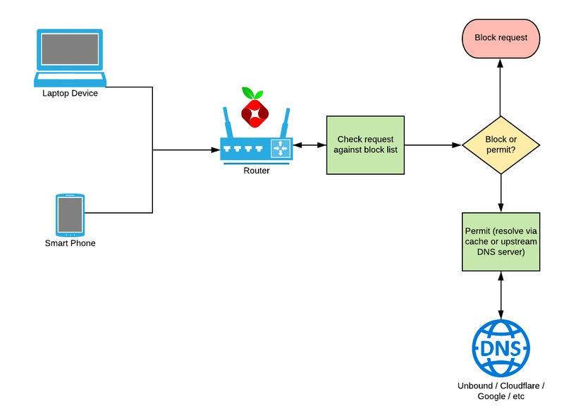
Introduction
How does Pi-Hole work ?

Slide 5
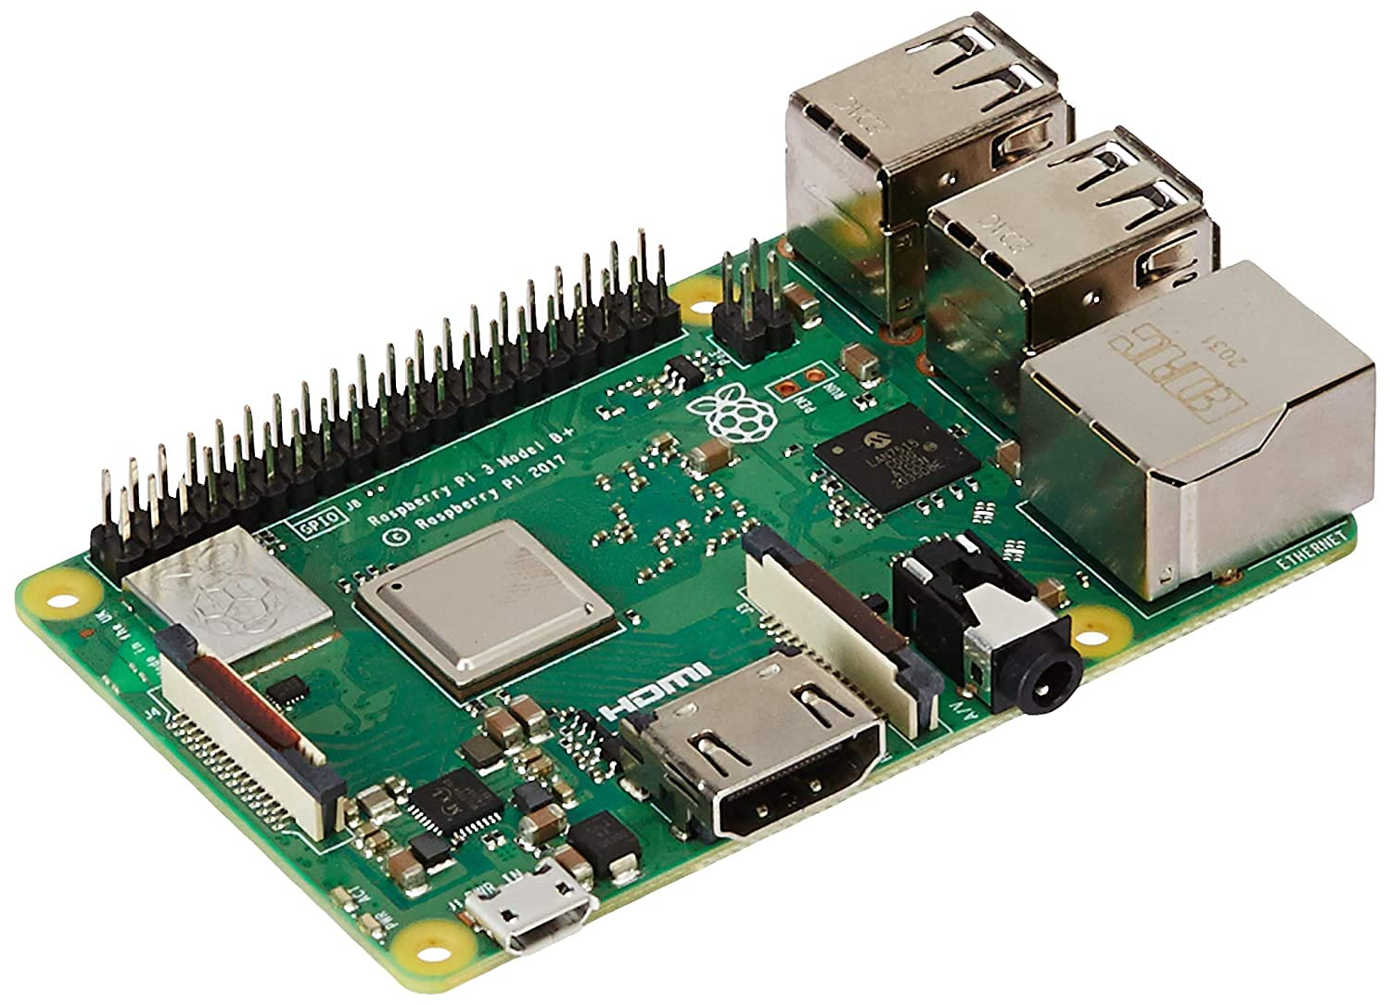
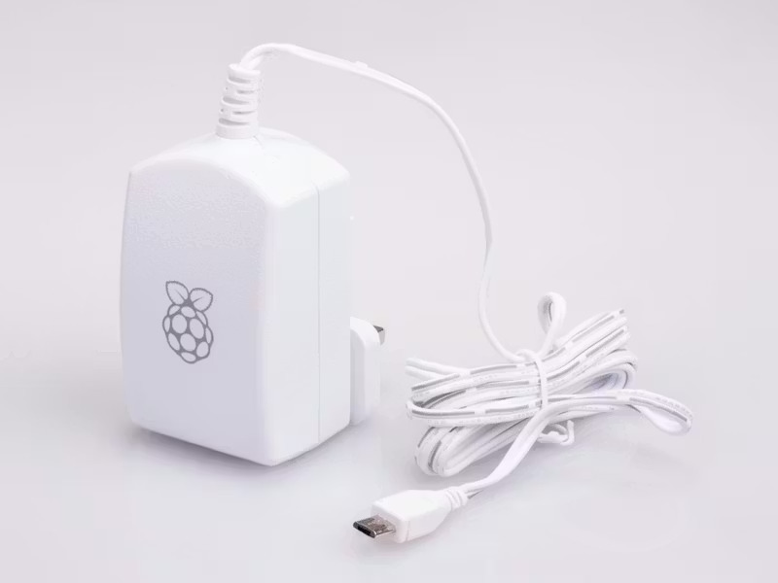
Equipment
Raspberry Pi model 3 b+.
A power supply converts power from the wall outlet to the Raspberry Pi.

Slide 6
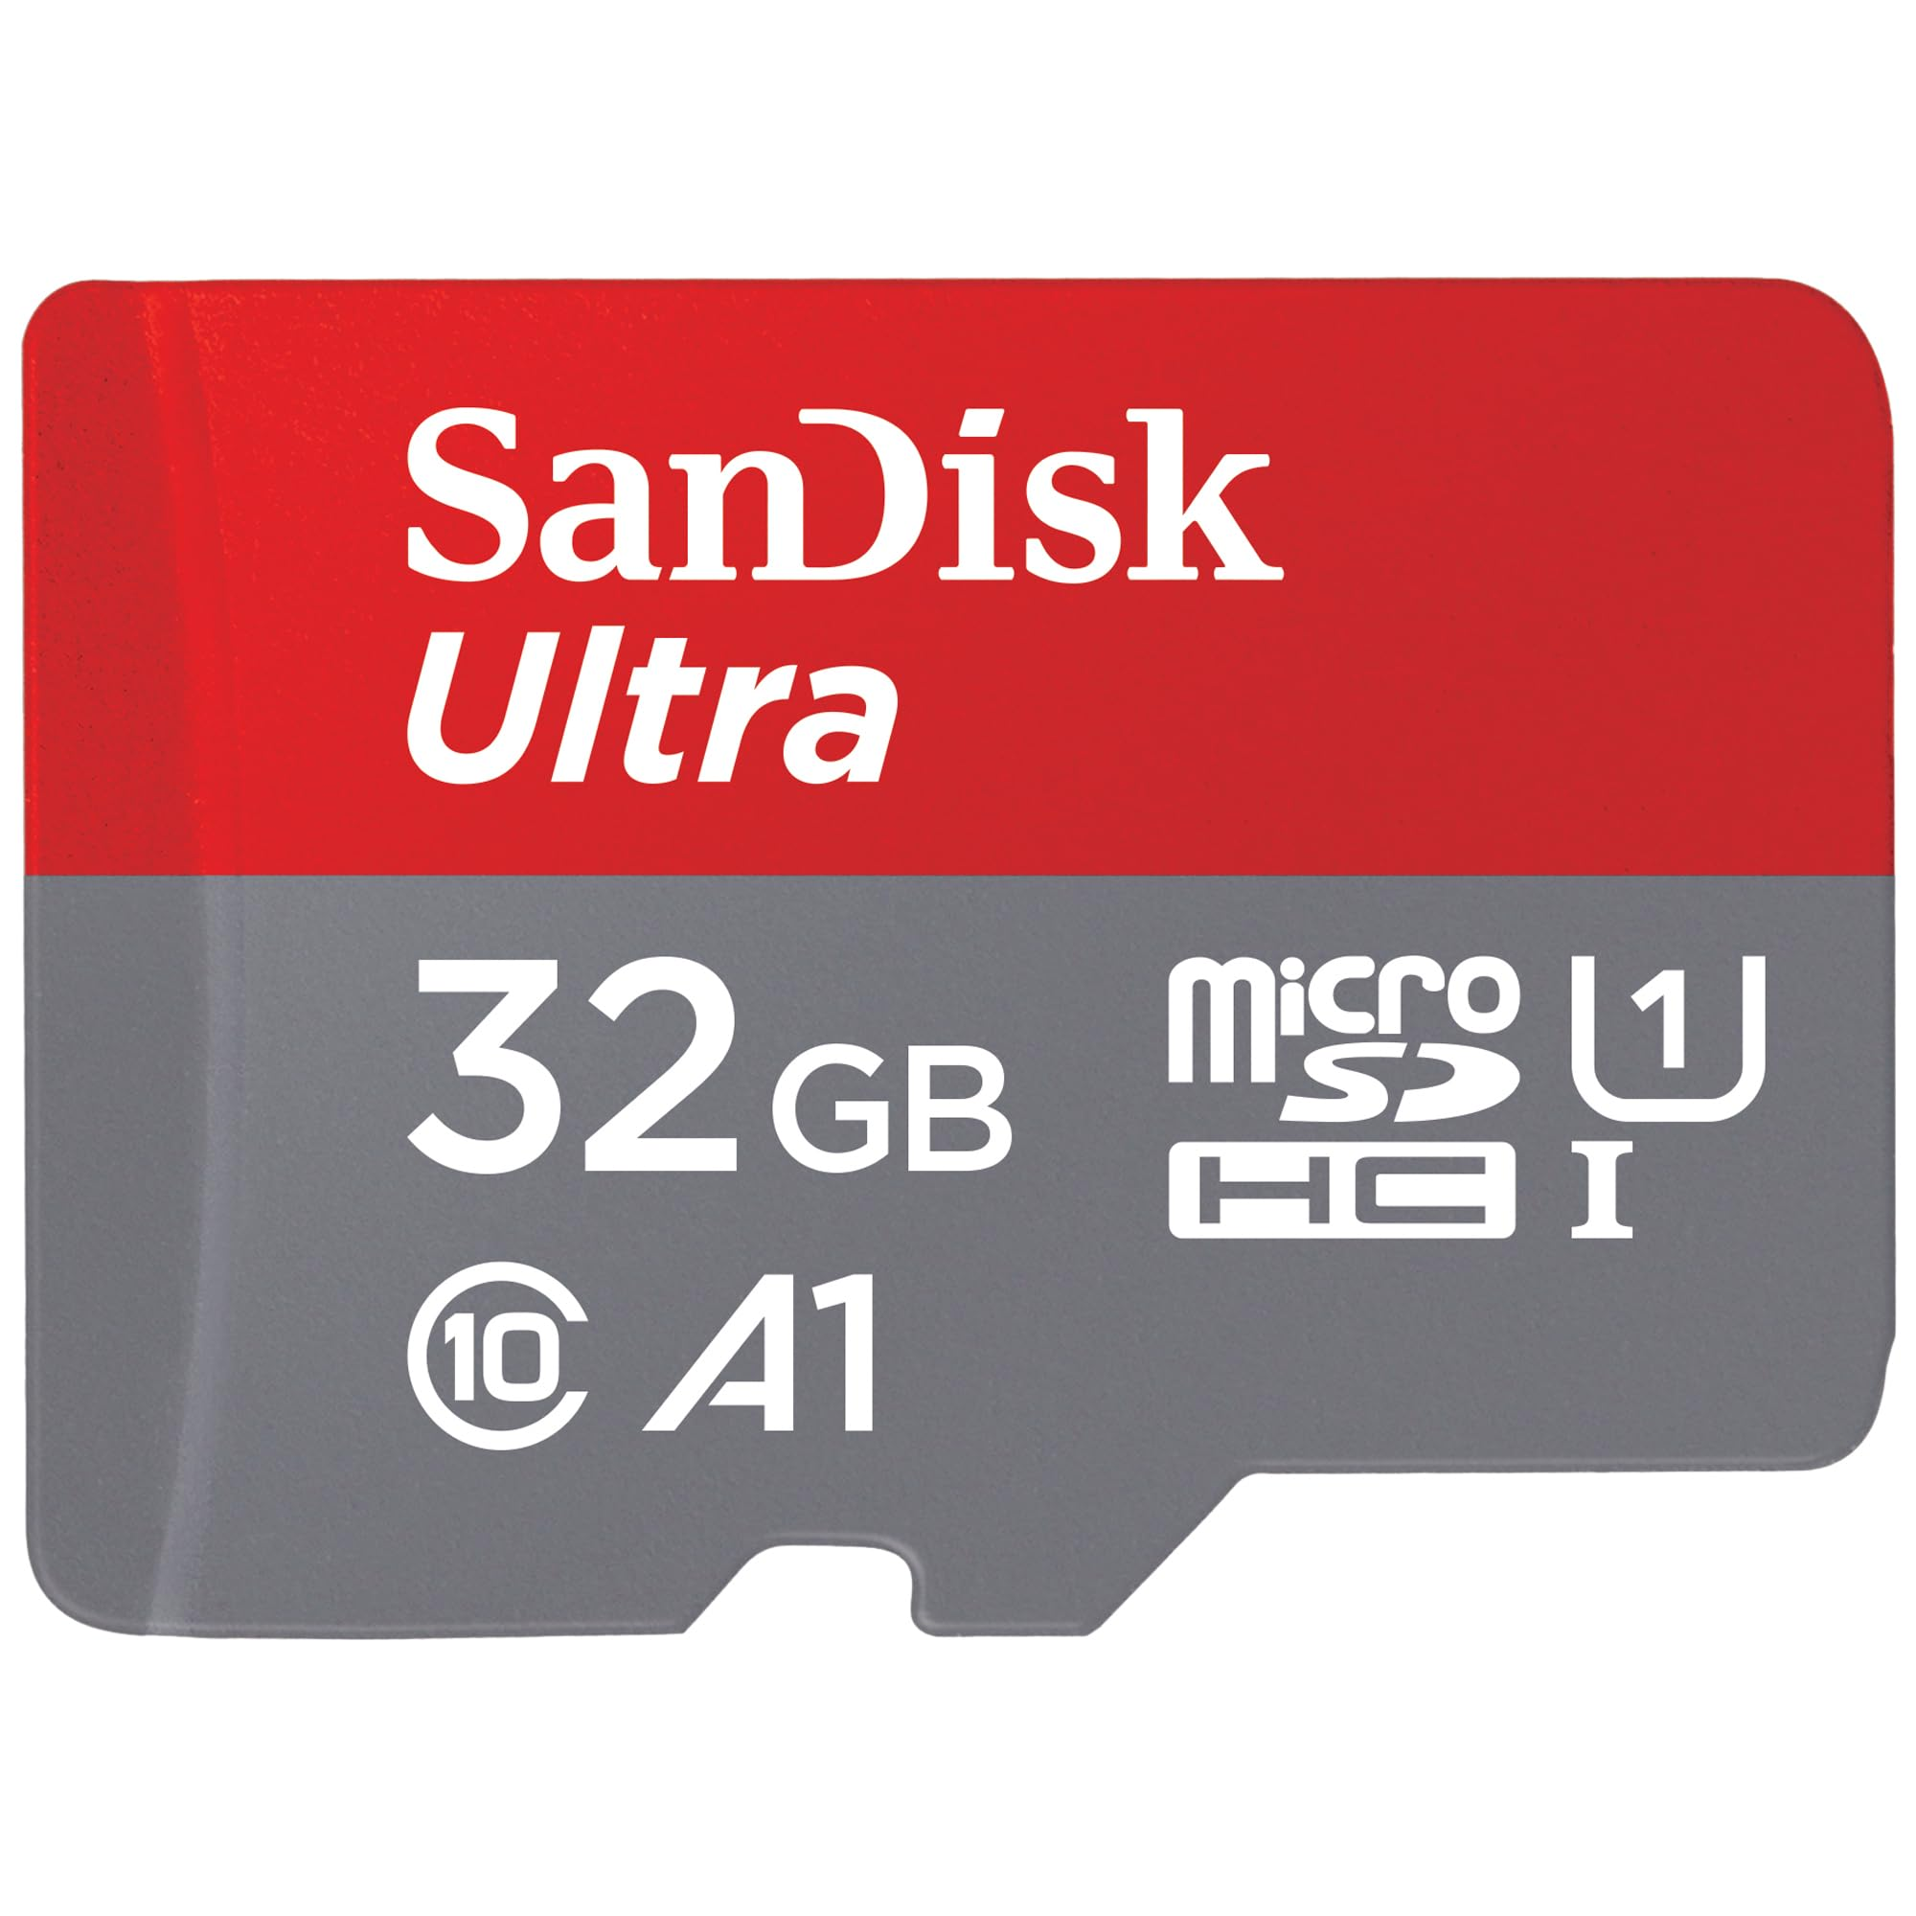
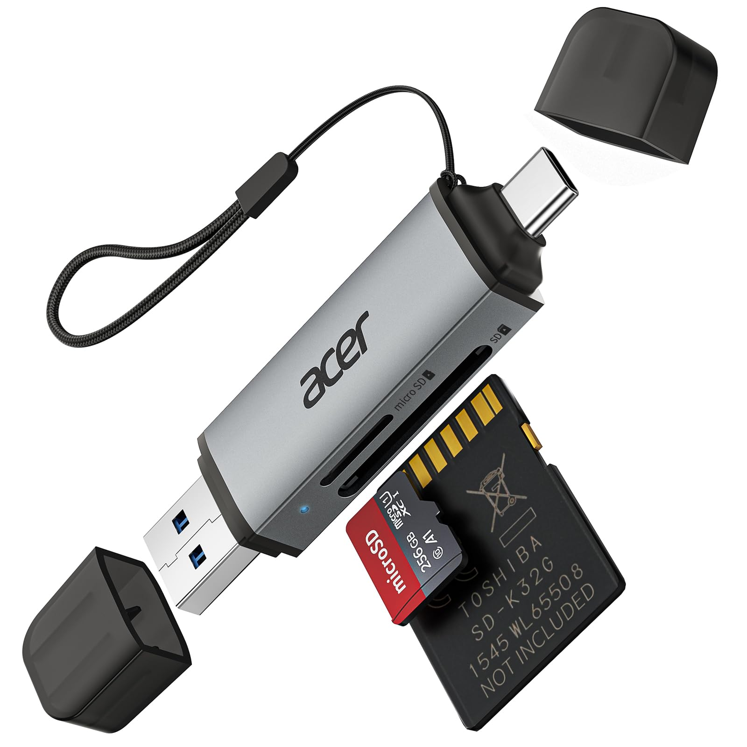
Equipment
A microSD card to flash the Raspberry Pi OS.
An adapter allows the usage of microSD cards in computers.

Slide 7
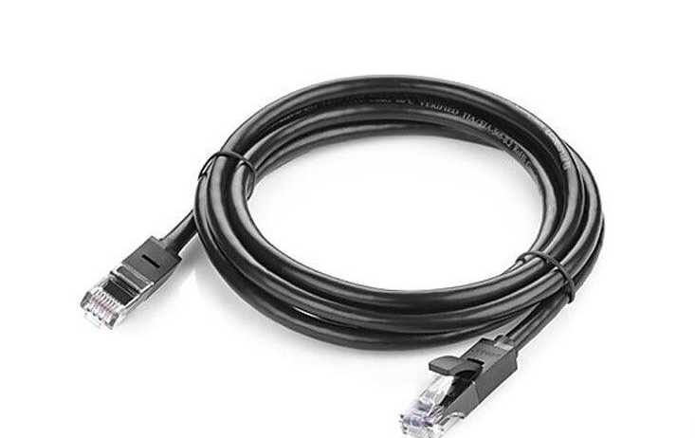
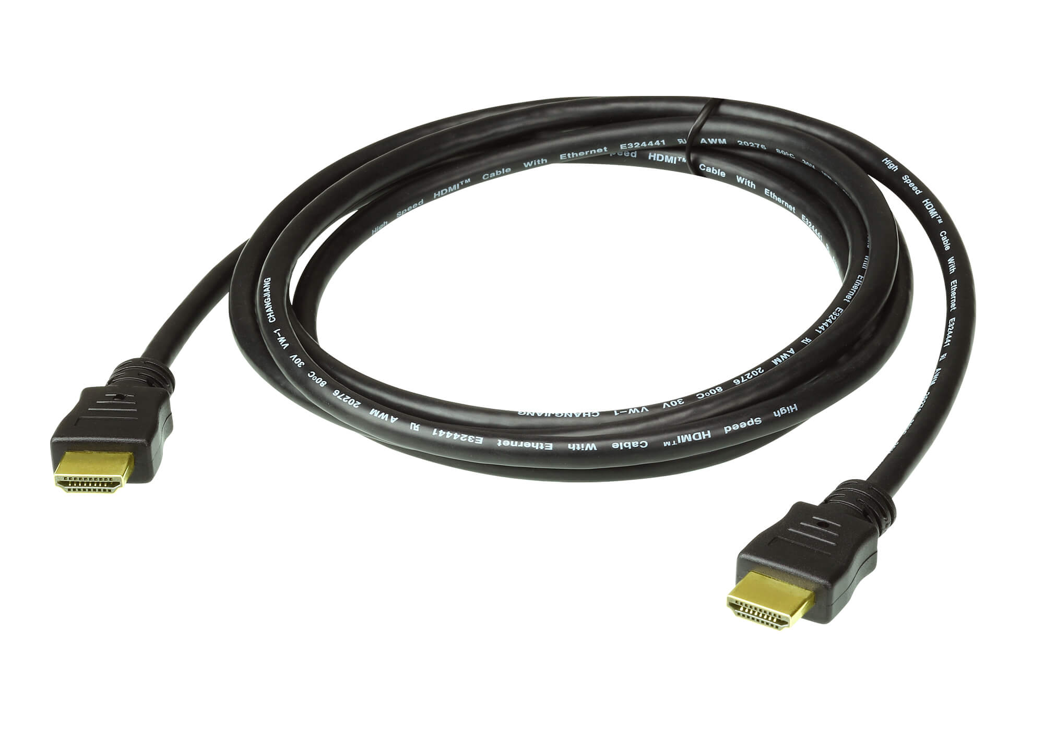
Equipment
A network cable allows the connection of the Raspberry Pi to the modem.
An HDMI cable allows the connection of the Raspberry Pi to a monitor.

Slide 8
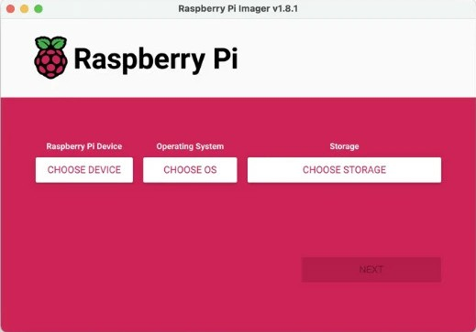
Setup – Raspberry pi os installation

Slide 9
Setup – Installation options
Imager
Connect
Docker
Remote access to existing installation
Runs on Container
Flashing SD card
For PC & servers
For Raspberry Pi
Connects securely to a Cloud
Doesn’t install Pi-Hole..
Not directly on OS
Installs Pi-Hole!
Installs Pi-Hole!
Directly on OS
Easiest Method
Advanced Method
Setup – Installation options

Slide 10
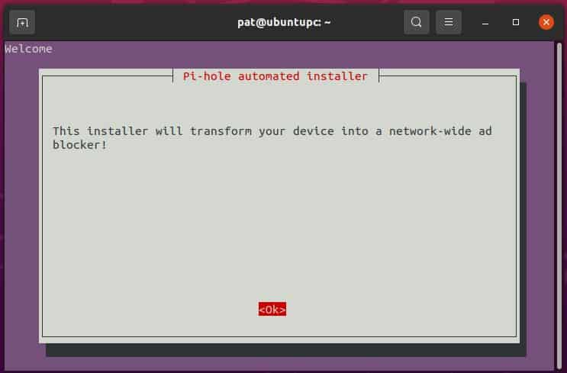
Setup – pi-hole installation
curl –sSL https://install.pi-hole.net | bash

Slide 11
Setup – Static Ip
What is a static IP?
Fixed internet protocol address used to maintain the same address whenever it’s connected to the internet.
What is DHCP?
Protocol in a local network that, when plugged to a device, automatically gives an IP address.
Correlation:
We use DHCP reservation, so Pi-Hole always has the same static IP. DCHP normally assigns dynamic Ips, but since Pi-Hole requires a fixed Ip, we use a DHCP reservation to make its IP static.
Setup – Static ip

Slide 12



Setup – network Connection
Ethernet
Wi-Fi
More stable & faster compared to Wi-Fi
Setup – network connection

Slide 13
Setup – upstream dns provider
DNS : Domain Name System
Distributed system that translates domain names (e.g. google.com) into Ip addresses so computers can locate servers on the internet.
Choice : Google DNS (8.8.8.8)
Considered to be the default DNS provider
Simple, reliable, reduces configuration complexity
Setup – upstream dns provider

Slide 14
Setup – Blocklist(s)
Suggestion : Steven Black’s List
Block list that contains weird and odd sites like:
Ads and trackers
Malware, malicious and suspicious domains
Extension: porn, gambling, fake-news, social media filters
Manually add other sites / hosts / domains to block later on as well.
More info : https://awesome-privacy.xyz/networking/host-block-lists/hosts-by-stevenblack
Setup – Blocklist(s)

Slide 15
Setup – Privacy levels
0
1
2
3
Show everything
Hide domains
Hide domains & clients
Anonymous mode
Setup – privacy levels

Slide 16
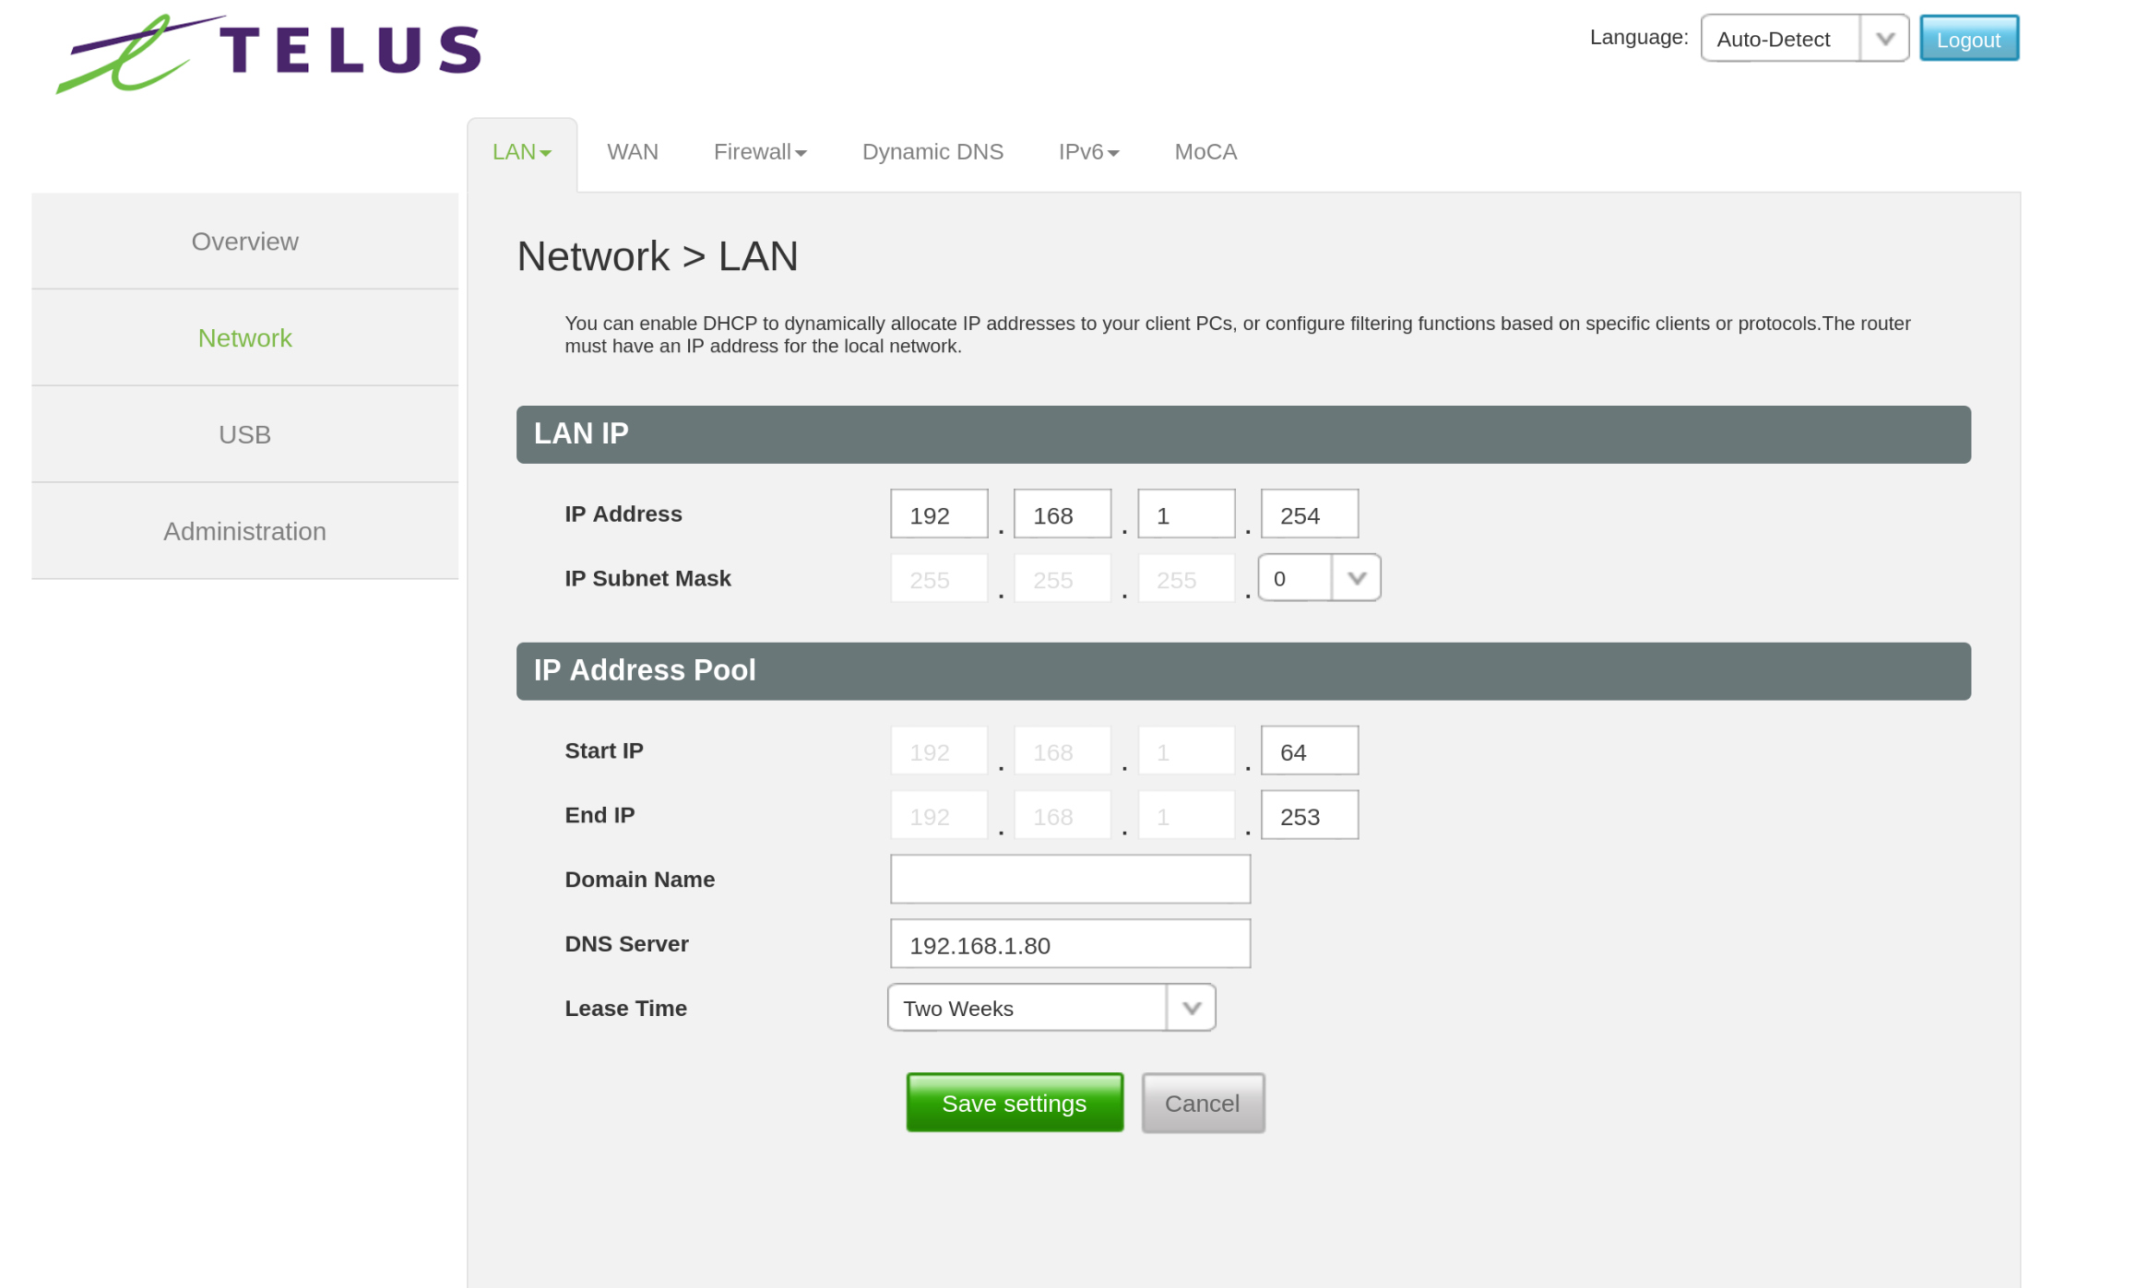
Setup – client connection

Slide 17
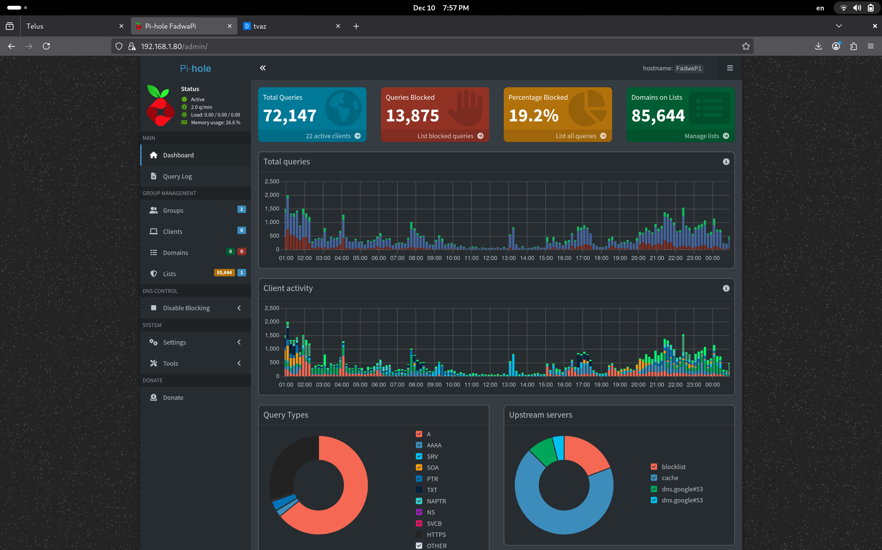
Demo – dashboard

Slide 18
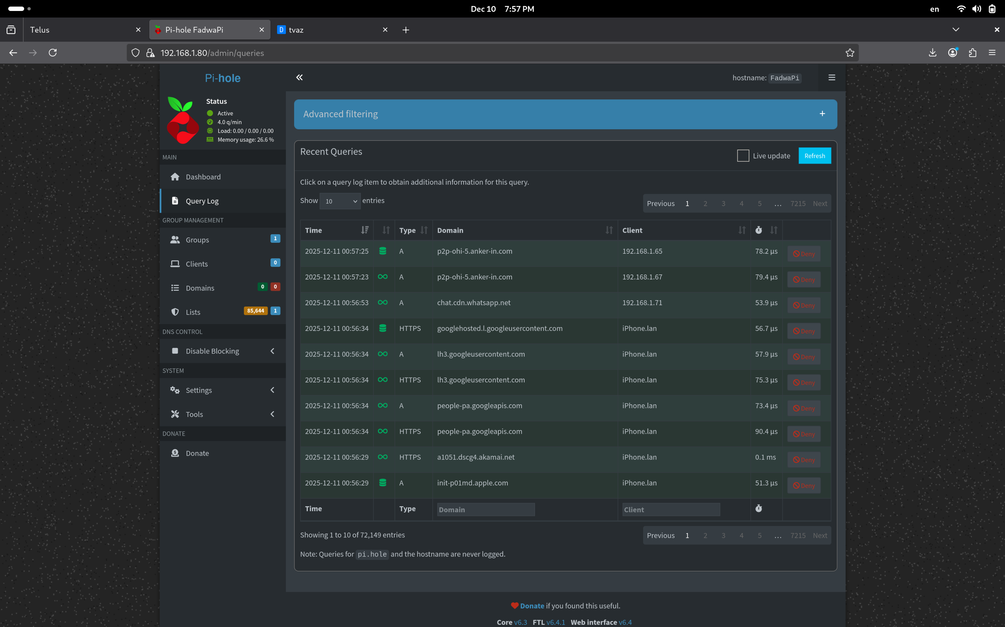
Demo – Query log

Slide 19
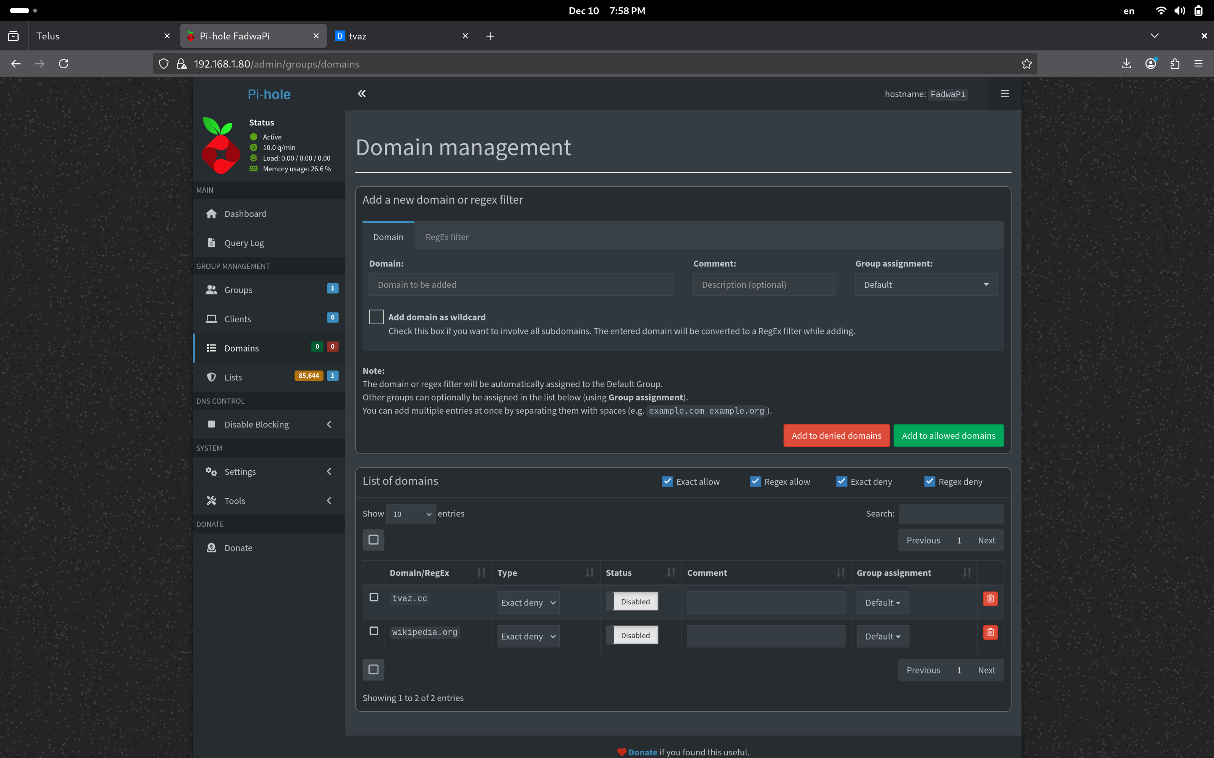
Demo – Domains

Slide 20
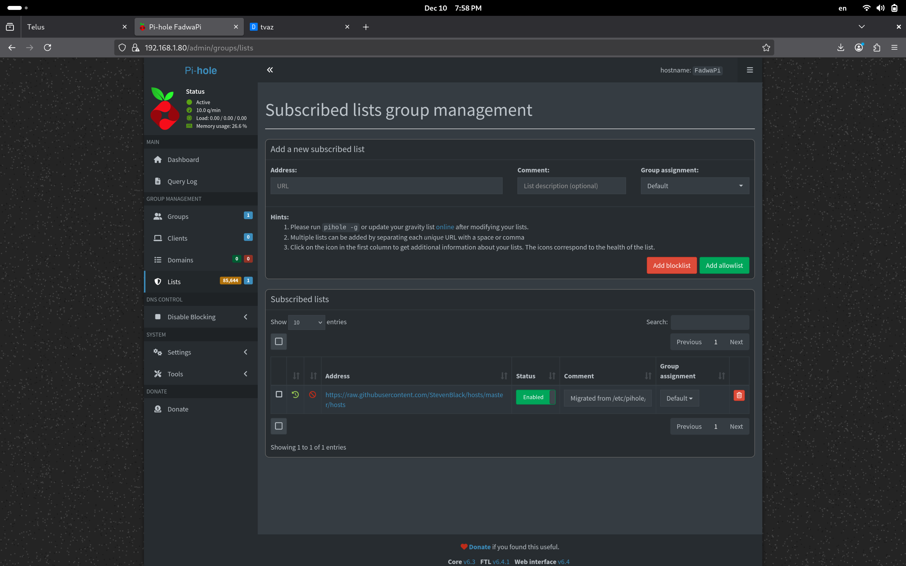
Demo – Lists

Slide 21
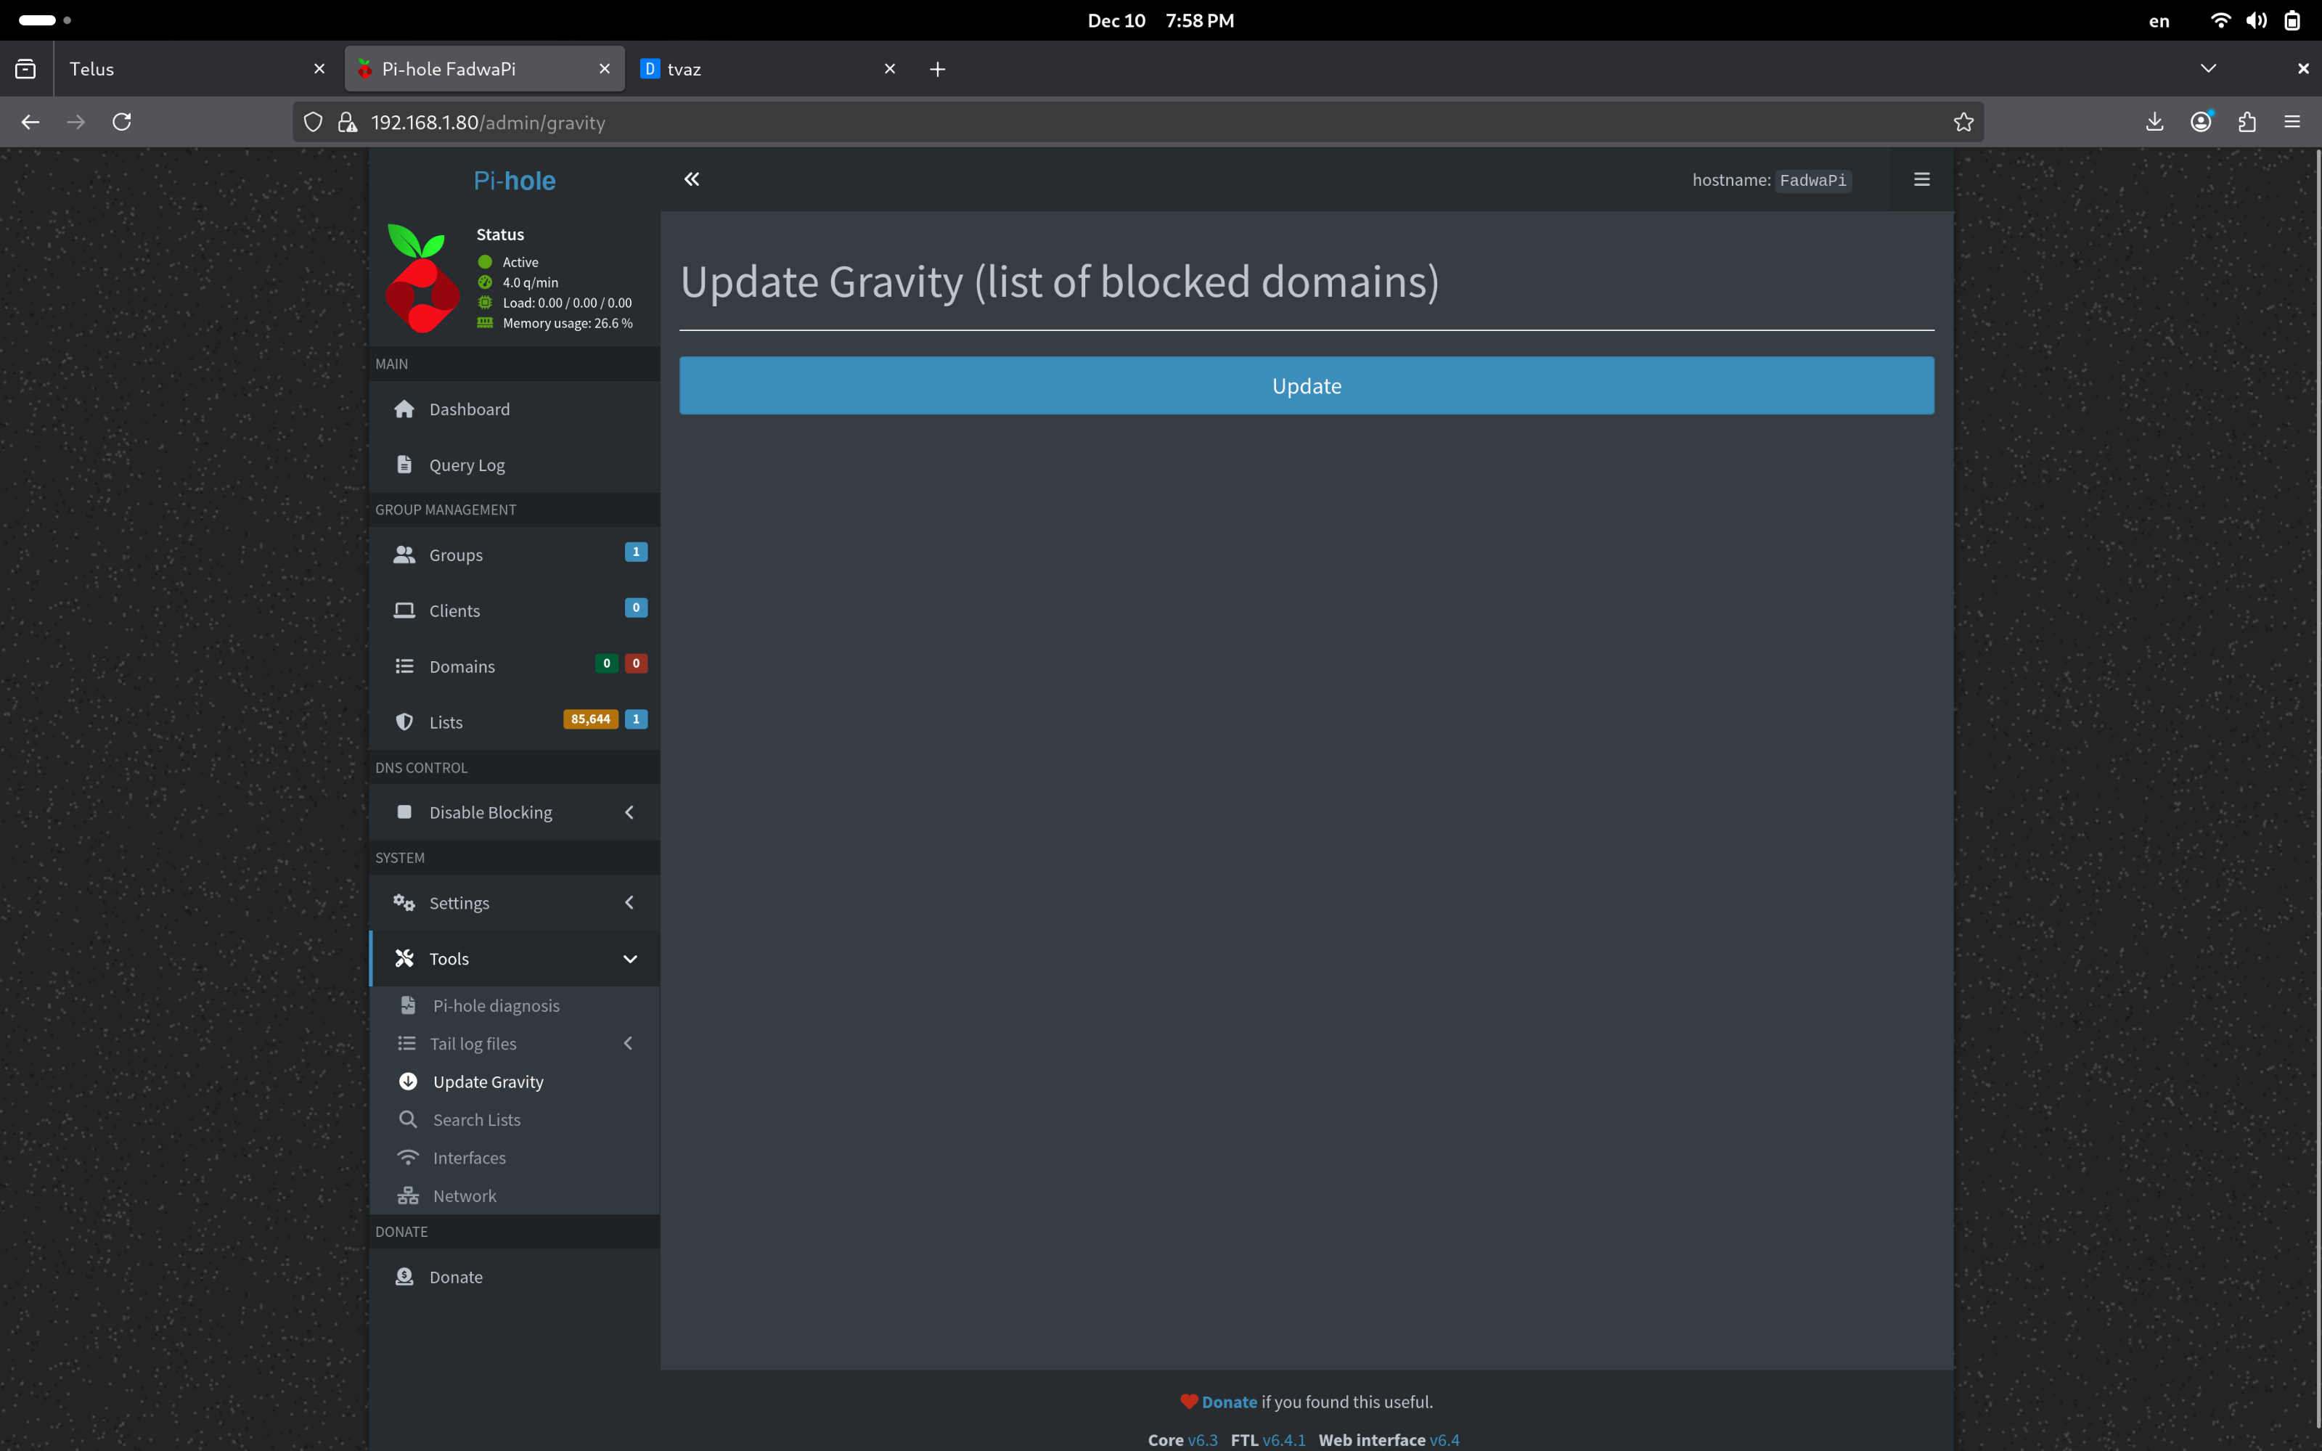
Demo –update gravity

Slide 22
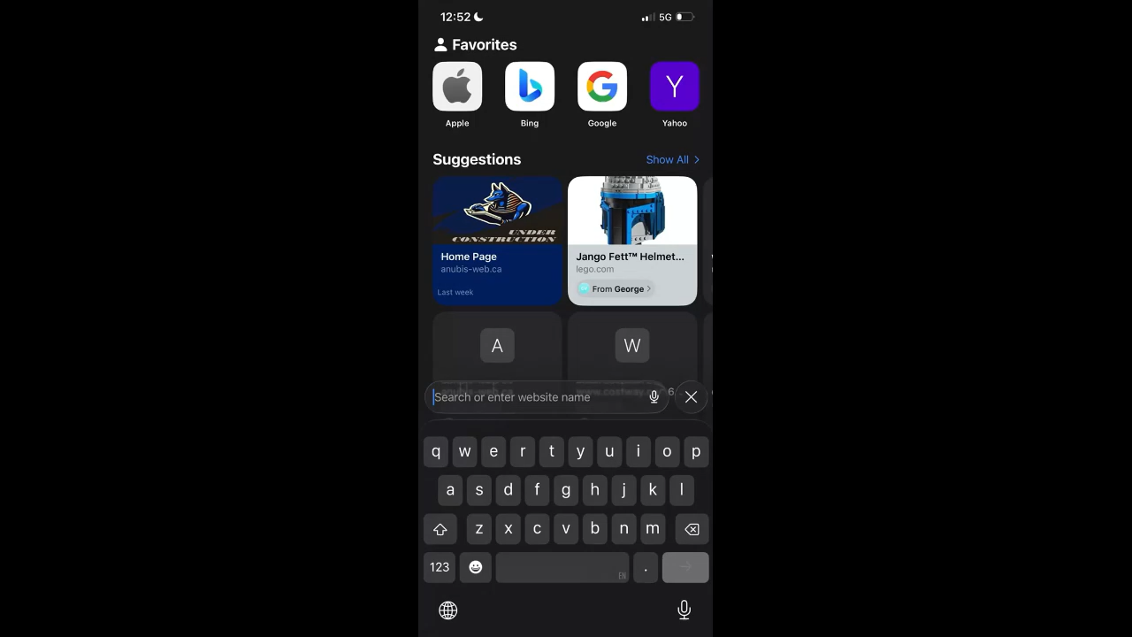
Demo

Slide 23
Conclusion
Purpose of pi-hole
Installation steps
Future plans

